Slide 1
NHDPlusV2 Network Value Added Attributes Part 2 Cindy McKay
NHDPlus Training Series
Notes:
Welcome to the NHDPlus Training Series. This webinar is part 2 of 4 part webinar set about NHDPlusV2 Network Value Added Attributes. I’m Cindy McKay, a member of the NHDPlus Team
The NHDPlusV2 Training Series is designed for new and experienced NHDPlus users. To get the most from the Series, students new to NHDPlusV2 are encouraged to read up through the "NHDPlusV2 Versioning System" section of the NHDPlusV21 User Guide, download and install some NHDPlus data (as described in Exercises 0 and 1 on the web site), and spend time exploring the content of NHDPlus.
The Training Series does not cover how the NHDPlusV2 components were built. This information can be found in Appendix A of the NHDPlusV21 User Guide.

Slide 2
Objectives
Learn the fundamentals of the Network Value Added Attributes
Learn how to perform various analyses using the attributes.
c
Objectives
Notes:
In Part 1, we covered the fundamentals of the Network Value Added Attributes and discussed the NHDFlowline and Navigation Attributes, including the installation and operation of the VAA Navigator. In this webinar, we’ll revisit the fundamentals. Then we’ll focus on the VAAs that are designed for analysis.

Slide 3
Agenda
Fundamentals
Analysis Attributes
Agenda
Notes:
In Part 1, we covered the fundamentals of the Network Value Added Attributes and discussed the NHDFlowline and Navigation Attributes, including the installation and operation of the VAA Navigator. In this webinar, we’ll revisit the fundamentals. Then we’ll focus on the VAAs that are designed for analysis.

Slide 4
NHDPlusV2 Network VAAs
The Fundamentals:
Computed from PlusFlow table and NHDFlowline.FlowDir, Ftype, GNIS_ID, LengthKM
Can not be computed unless NHDFlowline and Flow table pass the NHDPlus NHD QAQC checks.
VAA computations build on each other with QAQC checks to maintain consistency across attributes.
Computed for a complete drainage area.
All identifier VAAs are nationally unique.
Stored in the PlusFlowlineVAA table.
Fundamentals
Notes:
The NHDPlus network value added attributes are totally derived with software using the NHD network. The network connections are expressed in the PlusFlow table which is used along with the FlowDir (Flow Direction), Ftype (feature type), GNIS_ID (Geographic Names Information System identifier), and LengthKM (feature length).
The Network VAAs cannot be computed unless NHDFlowline and the PlusFlow table pass extensive QAQC checks created especially for NHDPlus.
The VAA computations build on each other. Each one depends on the values computed for one or more of the other VAAs. The computation software performs QAQC on the attributes as they are built to ensure consistency.
The VAAs are computed for a complete drainage area.
All identifier VAAs are nationally unique.
And finally, the Network VAAs are stored in the PlusFlowlineVAA table.

Slide 5
Analysis Attributes
Stream Order (StreamOrde)
Stream Calculator (StreamCalc)
Level Path Identifier (LevelPathI)
Terminal Path Identifier (TerminalPa)
Up Level Path Identifier (UpLevelPat)
Down Level Path Identifier (DnLevelPat)
Path Length (PathLength)
Arbolate Sum (ArbolateSu)
Return Divergence (RTNDIV)
Analysis Attributes
Notes:
The Analysis group of VAAs contains attributes designed to support various types of network analysis. The following slides discuss details of these attributes.

Slide 6
Stream Order (StreamOrde)
1
1
The headwater streams are called "first order". Two first order streams join to form a larger, second order stream; two second order streams join to form a third order, and so on. Smaller streams entering a higher-ordered stream do not change its order number.
2
1
1
2
1
2
3
Analysis Attributes
Notes:
The NHDPlusV2 Stream Order follows an adaptation of the Strahler stream order specification, according to which the headwater streams are called "first order". Two first order streams join to form a larger, second order stream; two second order streams join to form a third order, and so on. Smaller streams entering a higher-ordered stream do not change its order number. The Strahler specification is designed to be applied to a dendritic network. The NHDPlus network is not dendritic and contains nearly 60,000 flow splits or divergences.

Slide 7
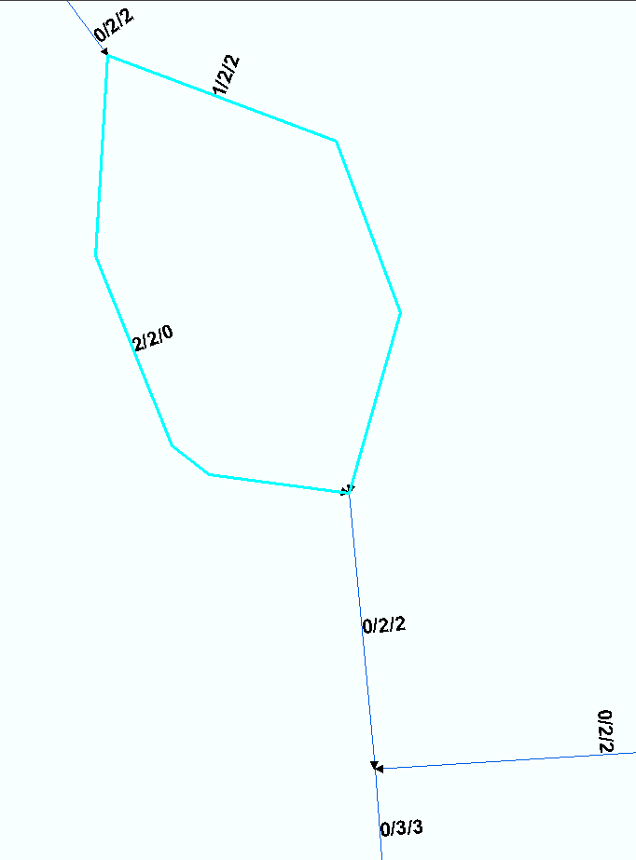
Stream Calculator (StreamCalc)
Divergence/
StreamOrde/
StreamCalc
Analysis Attributes
Notes:
When a divergence appears in the network, the stream order assignment methodology is altered. The current stream order is carried to the immediately downstream flowlines. And a new attribute called Stream Calculator is introduced. Stream Calculator is set equal to Stream Order for the main stem of the divergence. The other path (or paths) in the divergence receive a Stream Calculator value of 0.
The rules for assigning values to Stream Calculator are:
On a main path in the network, Stream Calculator is equal to Stream Order.
On a minor path in the network, Stream Calculator is 0 until that path returns to a main path.
In this example picture, each flowline is labeled with Divergence, Stream Order, and Stream Calculator separated by slashes. The direction of flow is from the top of the picture to the bottom of the picture. The upstream flowline has a Stream Order of 2 and flows into a divergence. The two flowlines in the divergences are assigned a Stream Order of 2. The minor path on the left side of the divergence is assigned a Stream Calculator of 0 while the main path on the right side is assigned a Stream Calculator equal to the Stream Order of 2.
At the bottom of the divergence, the minor path returns to the main path. Even though there are two flowlines of equal Stream Order flowing together, because one is a minor path (i.e. Stream Calculator = 0), the Stream Order is not incremented to 3. The Stream Order remains 2 and the Stream Calculator is set to 2 as well.

Slide 8
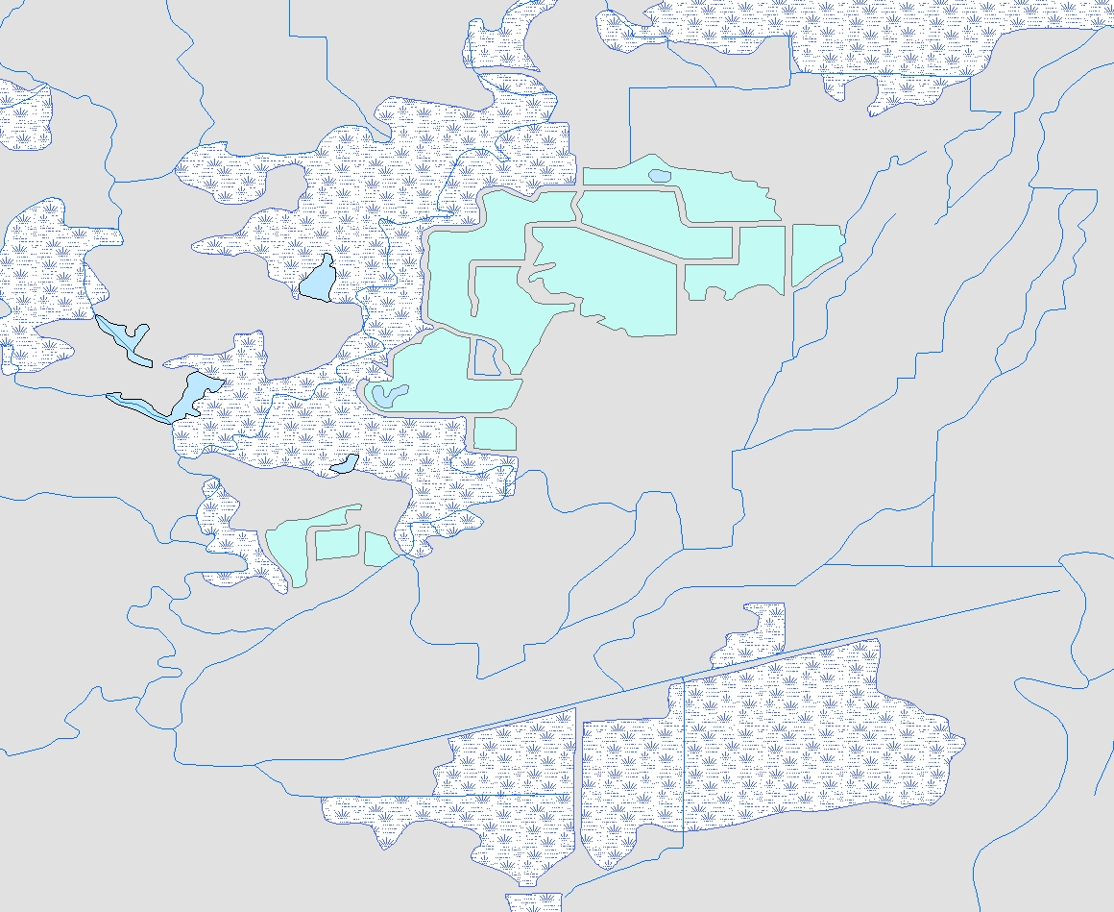
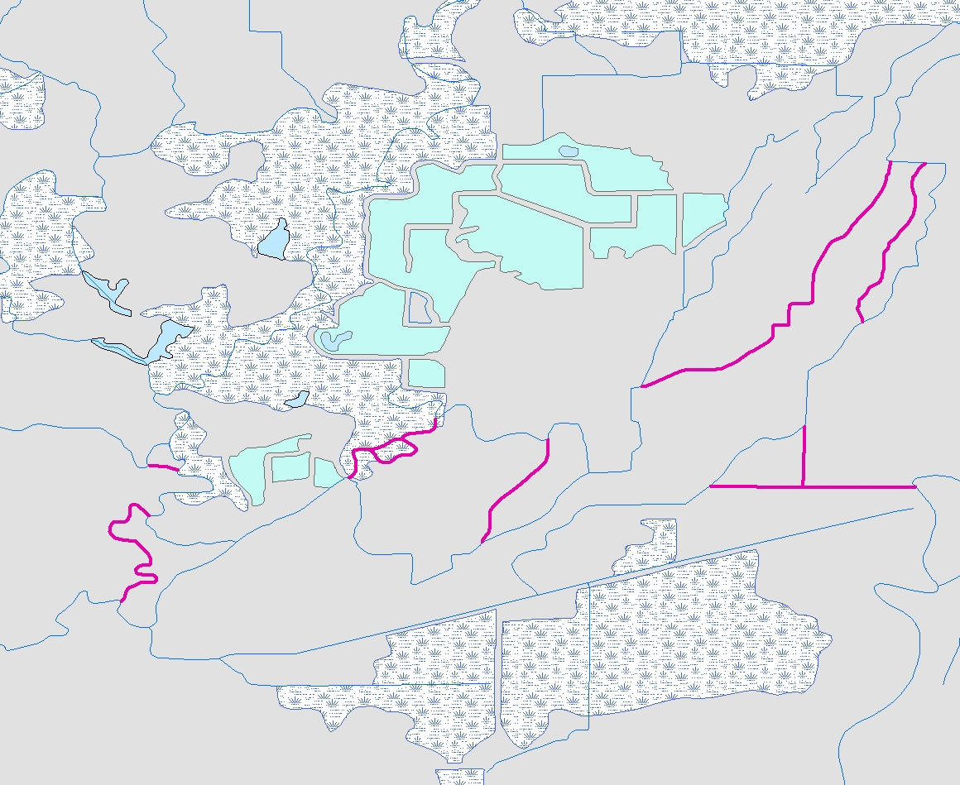
Using Stream Calculator
An Interesting Side Benefit of Stream Calculator – Removing StreamCalc <> StreamOrder from the NHDPlus network yields a dendritic network.
Analysis Attributes
Notes:
Stream Calculator has an interesting side benefit. By selecting flowlines with StreamCalc = 0 and removing them from the NHDPlus network, the resulting network is dendritic. A full network with many divergences is shown in the picture on the left. In the right-hand picture, the flowlines with StreamCalculator = 0 are highlighted in purple. You can see that these are the minor paths of each divergence and that removing them leaves a dendritic network.

Slide 9
Level Path Identifier (LevelPathI)
LevelPathI = 55
2
1
The hydrologic sequence number of the most downstream flowline on the same level path.
1
2
2
3
1
2
1
HydroSeq = 55
Analysis Attributes
Notes:
Level Path ID is a unique identifier assigned to a path with a given Stream Level value. The ID is assigned beginning with the most downstream flowline on the level path and then to every flowline along the level path until the top of the network is reached. For convenience, the hydrologic sequence number (HydroSeq) of the most downstream flowline on the level path is used as the Level Path ID.
In this example picture, the path with stream level of 1 is assigned a level path ID of 55 which is equal to the Hydroseq of the most downstream flowline on the path.

Slide 10
Terminal Path Identifier (TerminalPa)
TerminalPathID = 55
The hydrologic sequence identifier for the terminal flowline to which a flowline ultimately flows.
Hydrologic Sequence Number = 55
Analysis Attributes
Notes:
Terminal Path ID is a unique identifier assigned to all the flowlines that drain to a given network terminus. The ID is assigned beginning with the network terminus and to every flowline upstream of that terminus. For convenience, the hydrologic sequence number (HydroSeq) of the terminus flowline is used as the Terminal Path ID.
In this example picture, the terminal flowline has a Hydroseq of 55 and all the flowlines in this network are assigned a terminal level path ID of 55.

Slide 11
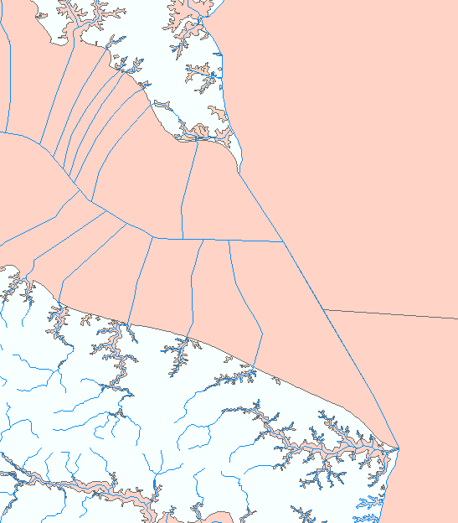
Using Level Path Identifier
Hydroseq = 20004858
Analysis Attributes
Notes:
The picture on this slide shows the mouth of the Potomac River. The hydroseq of the most downstream flowline is 20004858.

Slide 12
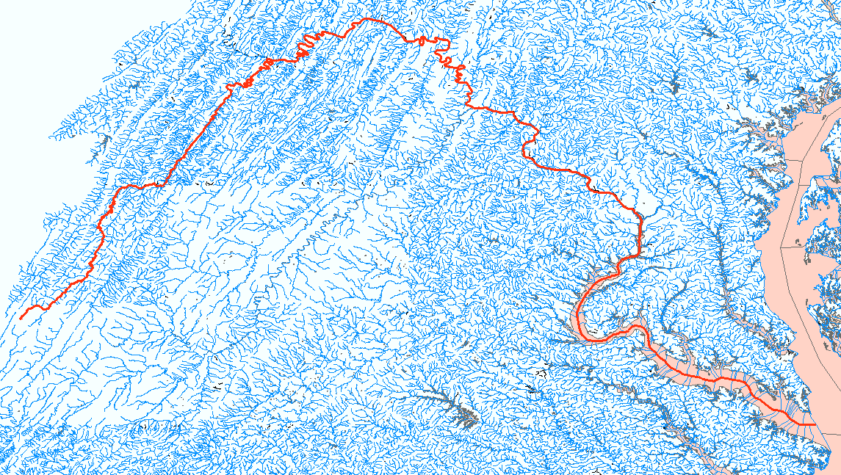
Using Level Path Identifier
LevelPathI = 20004858
Analysis Attributes
Notes:
By selecting all NHDFlowlines with Level Path ID = 20004858, we can see the level path that flows to the mouth of the Potomac.

Slide 13
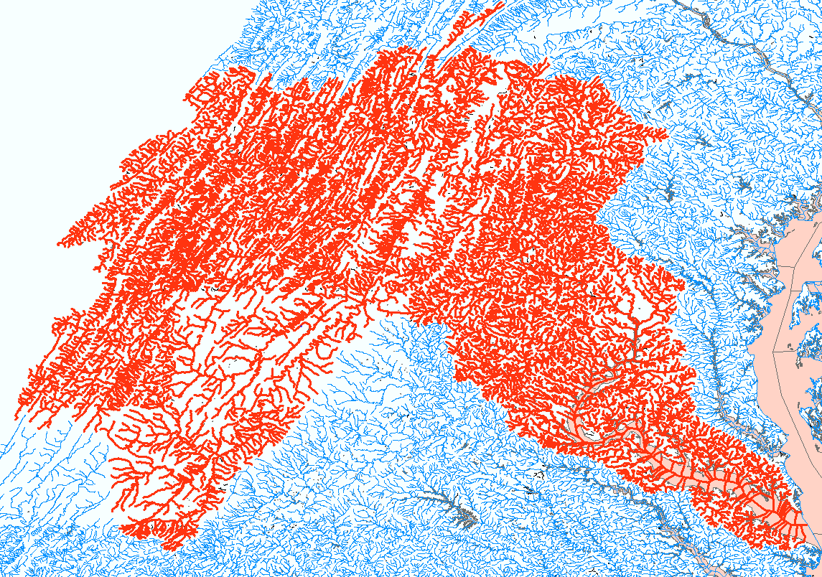
Using Terminal Path ID
TerminalPa = 20004858
Analysis Attributes
Notes:
By selecting all NHDFlowlines with Terminal Path ID = 20004858, we can see the entire drainage area that flows to the mouth of the Potomac.

Slide 14
Up & Down Level Path Identifier
(UpLevelPat, DnLevelPat)
The LevelPathIDs of the main path flowlines immediately upstream and downstream.
Analysis Attributes
Notes:
As their name implies, the Up Level Path Identifier and the Down Level Path Identifier hold the Level Path Identifiers of the main path flowlines immediately upstream and downstream respectively.
These attributes are often handy. For example, by comparing the Level Path Identifier to the Down Level Path Identifier, it’s possible to know whether you are at the bottom of a tributary.

Slide 15
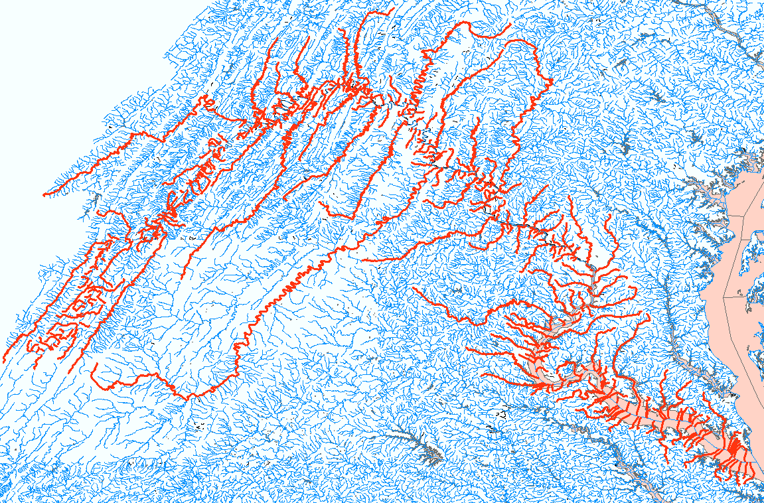
Using Level Path Id and Down Level Path Id
LevelpathID <> 20004858 & DnLevelPathID = 20004858
Analysis Attributes
Notes:
The example picture on this slide shows all the tributaries that flow directly to the Potomac. The selection in red is achieved by first selecting all the flowlines with LevelPathID <> 20004858 (i.e. the level path id of the Potomac) and with a Down LevelPathID = 20004858. This selection finds the bottoms of the level paths of the tributaries. Then selecting all the flowlines with Level Path IDs equal to any of the selected Flowlines will provide the selected set shown in the picture.

Slide 16
Path Length (PathLength)
The distance from the downstream end of a flowline to the network terminus
Analysis Attributes
Notes:
Path Length holds the distance in kilometers from the bottom of a flowline to the network terminus.

Slide 17
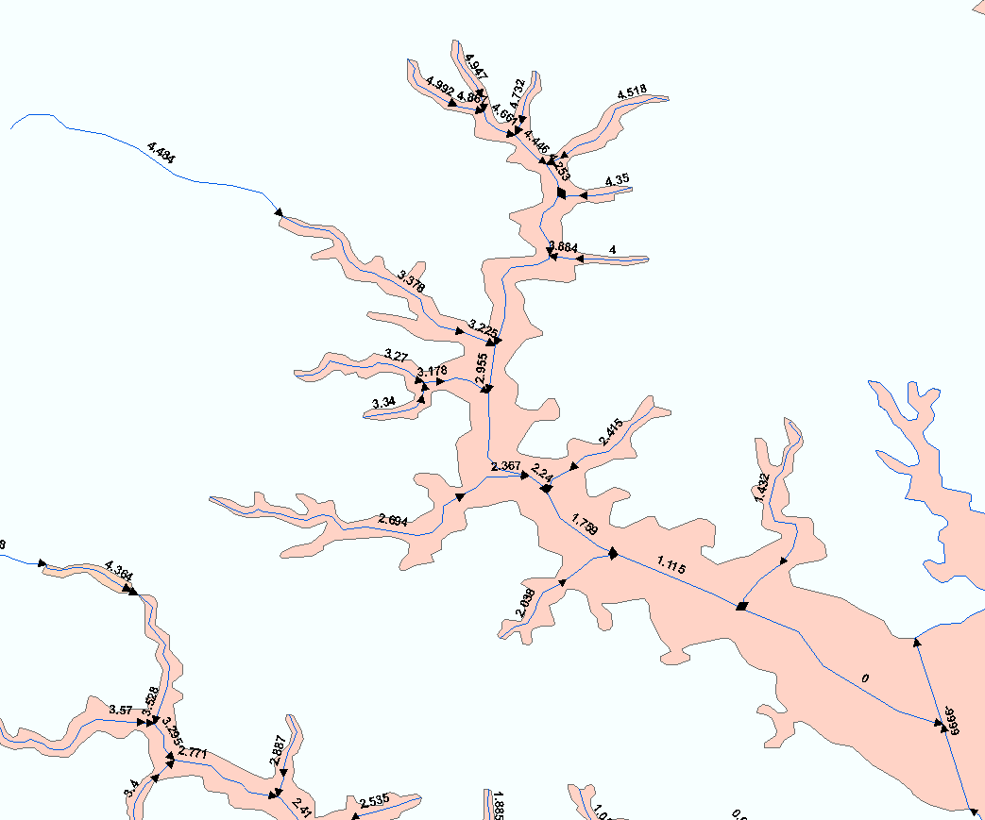
Using Path Length (Pathlength)
Analysis Attributes
Notes:
Pathlengths are shown as labels in this picture. Note that Path length decreases as you move down the network toward the terminus.

Slide 18
Arbolate Sum (ArbolateSu)
The sum of LengthKM from the bottom of the flowline to the headwaters of the drainage area.
Analysis Attributes
Notes:
A flowline’s Arbolate Sum is the sum of the length of all the flowlines upstream of the flowline.

Slide 19
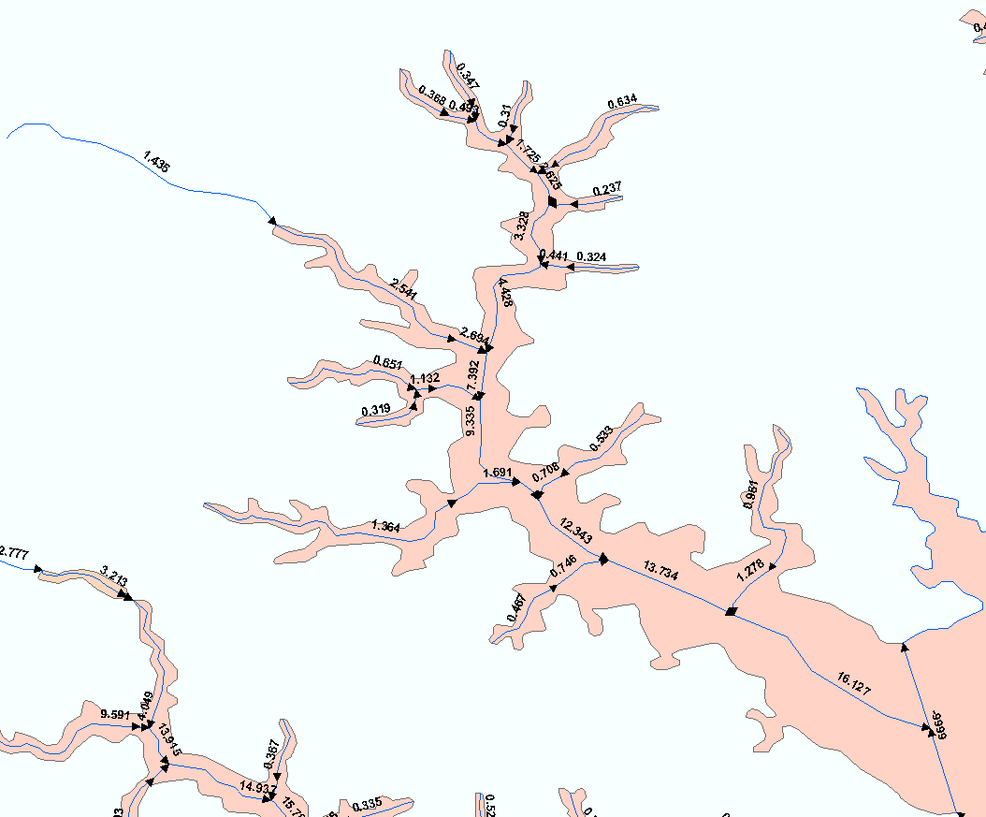
Using Arbolate Sum
Analysis Attributes
Notes:
Arbolate Sum is shown as labels in this picture. Note that Arbolate sum increases as you move down the network toward the terminus.

Slide 20
Return Divergence (RTNDiv)
0
0
Set to 1 when an upstream divergence returns to the network at the top of the flowline,
Otherwise 0.
0
0
0
0
0
1
Analysis Attributes
Notes:
Return Divergence is a flag that indicates that an upstream divergence has come back together in the network. In this example picture, there are two divergences. One of the divergences returns to the network and the next flowline downstream receives a Return Divergence code of 1.

Slide 21
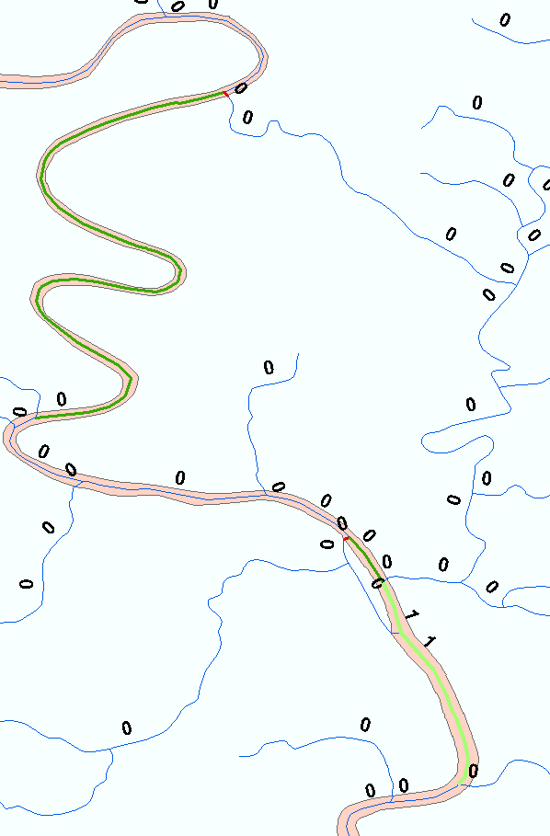
Using Return Divergence
Dark Green = Major Divergent Path
Red = Minor Divergent Path
Light Green = RTNDIV 1
Analysis Attributes
Notes:
The primary use of Return Divergence is during the accumulation of attributes from the top to the bottom of the network. If there were no divergences in the network, the accumulation task could be done by adding, at each flowline, the values from the flowlines immediately upstream. However, at divergences, the total amount being accumulated needs to be routed down all the paths of the divergence. When those paths come back together, adding the values from the flowlines immediately upstream will result in duplicating the amounts that were routed at the upstream divergence. So when Return Divergence is 1, the proper way to determine the accumulated amount is to navigate upstream including tributaries and adding all the individual flowline amounts.

Slide 22
Resources
Additional information on NHDPlus is available from the NHDPlus website documentation page. You are encouraged to read and reference the NHDPlusV21 User Guide and other NHDPlus documentation.
The NHDPlus team maintains a user email list and periodically sends emails regarding new tools, data, documentation, and events. If you would like to be on the user list, send an email to nhdplus-support@epa.gov
The NHDPlus team also provides technical support to users of the data and tools. If you have a technical support question, please send a detailed email to nhdplus-support@epa.gov
Resources

