Slide 1
NHDPlusV2 Burn Components
Craig Johnston
NHDPlus Training Series
Notes:
Hello, I’m Craig Johnston of the NHDPlus team. This NHDPlus webinar describes the NHDPlusV2 Burn Component datasets used for hydro-enforcement of digital elevation models to produce the NHDPlus HydroDEM and its derivative products.
The NHDPlusV2 Training Series is designed for new and experienced NHDPlus users. To get the most from the Series, students new to NHDPlusV2 are encouraged to read up through the "NHDPlusV2 Versioning System" section of the NHDPlusV21 User Guide, download and install some NHDPlus data (as described in Exercises 0 and 1 on the web site), and spend time exploring the content of NHDPlus.
The Training Series does not cover how the NHDPlusV2 components were built. This information can be found in Appendix A of the NHDPlusV21 User Guide.

Slide 2
Objectives
Describe how the Burn Component datasets serve as feature level metadata for the hydro-enforcement and catchment delineation process
Identify a limitation with the use of BurnLineEvent
Objectives
Notes:
In this presentation we will describe how the NHDPlus Burn Components serve as feature level metadata for the hydro-enforcement and catchment delineation process. We will also discuss a limitation of the use of BurnLineEvent.

Slide 3
Agenda
Stream Burn Ingredient Datasets
BurnLineEvent.dbf
BurnAddLine.shp
Waterbody Burn Ingredient Datasets
BurnWaterbody.shp
BurnAddWaterbody.shp
Sink.shp
Wall.shp
LandSea.shp
Agenda
Notes:
Today’s webinar agenda will describe the various NHDPlus Burn Components. This includes two stream burn ingredient datasets: BurnLineEvent.dbf and BurnAddLine.shp; Two Waterbody Burn datasets: BurnWaterbody.shp and BurnAddWaterbody.shp; and:
Sink.shp
Wall.shp
LandSea.shp

Slide 4
Documenting the Hydro-enforcement and Catchment Delineation Process
NHDPlus UserGuide
Explains the general methods applied for creating the HydroDem, Flow Direction / Accumulation grids, and Catchment data
NHDPlus BurnComponents
Provides feature level documentation from multiple sources.
Explains what was used for hydro-enforcement and the
catchment delineation process
NHDPlus Hydro-enforcement documentation
Notes:
As mentioned previously, the NHDPlus BurnComponents provides feature level documentation about what was used for hydro-enforcement and catchment delineation. For more details about the hydro-enforcement process itself, refer to the NHDPlus UserGuide.

Slide 5
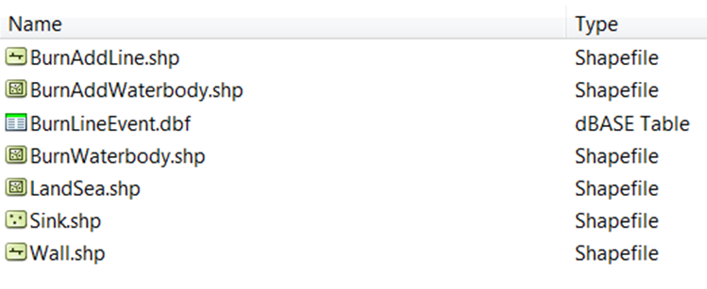
NHDPlusV2 Burn Components are packaged by Vector Processing Unit (VPU)
NHDPlusMA\NHDPlus02\NHDPlusBurnComponents
Contents of standard NHDPlusBurnComponents workspace for a VPU
NHDPlus VPU Burn Components folder
Notes:
The NHDPlusV2 Burn Components are packaged and distributed at the Vector Processing Unit (VPU) level. For each NHDPlus VPU, the NHDPlusBurnComponents folder contains feature datasets with the same file naming structure. The data contents within these files are specific to their respective VPU.

Slide 6
Stream Burn Ingredients
Hydro-enforcement of vector streams controlled by two PlusBurnComponent files
BurnLineEvent – dBase Table
Table of networked medium resolution NHDPlus flowline features
(FlowDir = “with-digitized”)
Attributes drive how these features are used and rendered
BurnAddLine – Shapefile
Line feature class of stream features used solely for the Hydro-enforcement process and not a networked NHDPlus flowline feature
Stream Burn Ingredients
Notes:
In the next several slides, we will begin by discussing two datasets used to enforce linear hydrography features into the DEM. The enforcement of these features is often referred to as “stream-burning”.
The first dataset, BurnLineEvent, is a dBase table that includes just networked NHDPlus flowline features from the NHDSnapshot. Networked flowline features are those coded in the NHD as FlowDir = “with-digitized”. Because only “with-digitized” features are included in BurnLineEvent, the NHD attribute FlowDir is not included in this table. Additional attributes in BurnLineEvent drive how the features in this table are used in the process of hydro-enforcement and catchment delineation.
The second dataset, BurnAddLine. is a shapefile of stream features used solely for the hydro-enforcement process. It does not include networked NHD flowlines from the NHDSnapshot.

Slide 7
BurnLineEvent - dBase file
Distributed as an NHD Linear Event table in dBase format
Attributes control whether a flowline is to be used in the stream burning process or for catchment delineation (or both)
Catchment = “Y” line will receive a catchment
“N” will not receive a catchment
Burn = “Y” line will be used for hydro-enforcement (stream-burning)
“N” will not be used for hydro-enforcement
BurnLineEvent
Notes:
BurnLineEvent is the only dataset of the BurnComponents that is distributed as an NHD linear event table. The reasons for this will be explained in a moment. Perhaps the most informative attributes in BurnLineEvent are the fields CATCHMENT and BURN, which can take values of “Y” for yes or “N” for no.
If a flowline feature has a CATCHMENT value of Y it will be used for catchment delineation. Likewise, if the flowline has a Burn property set to Y, it will be hydro-enforced (i.e., burned) into the DEM. In most cases, the flowlines CATCHMENT and BURN properties will both be set to Yes; In some cases, a combination of Yes and No scenarios will be present in a particular flowline’s CATCHMENT and BURN property settings.

Slide 8
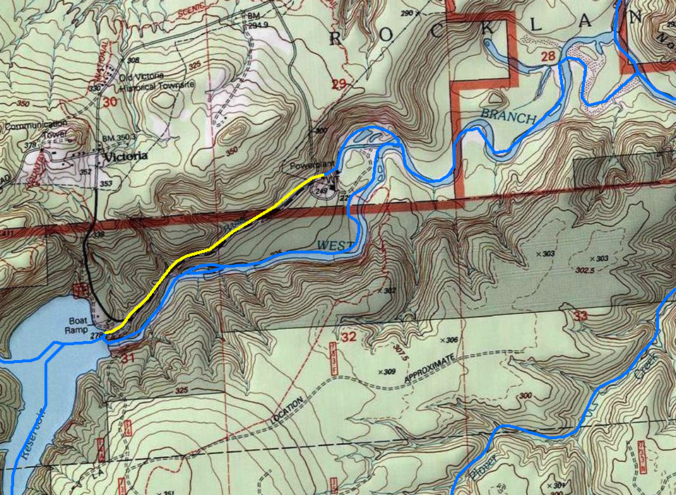
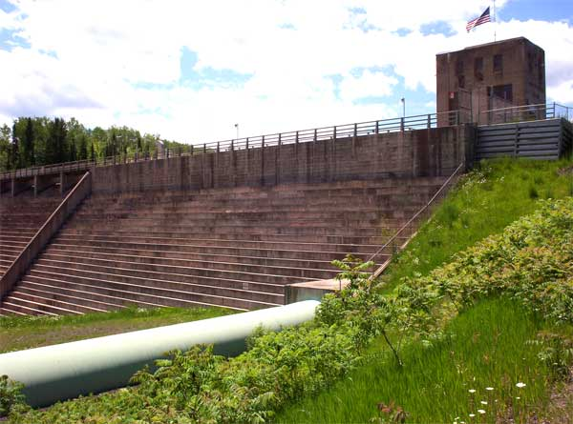
Victoria Reservoir Michigan
NHD Flowline FTYPE = Pipeline
BurnLineEvent Catch/Burn Attributes
Catchment = N
Burn = N
Notes:
This slide illustrates an example of a flowline with Burn and Catchment properties both set to NO (“N”) in BurnLineEvent. The feature is a pipeline that moves water via gravity from Victoria Reservoir to a small hydroelectric power plant. NHDPlus routes a percentage of the Reservoir’s outflow through this pipeline. The pipeline should not be assigned a local catchment drainagearea nor is it appropriate to burn this feature into the DEM.

Slide 9
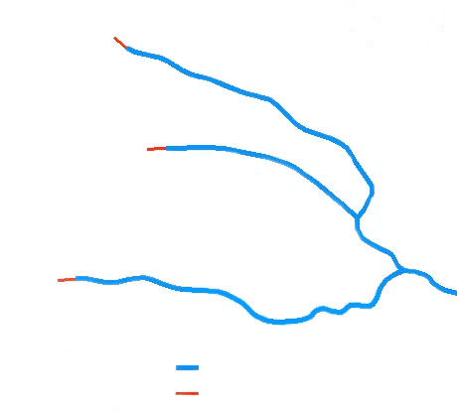
BurnLineEvent - dBase file
Can be rendered to a shapefile using the NHD linear event fields (FromMeas, ToMeas, ReachCode) with \NHDSnapshot\Hydrography\NHDFlowline.shp
Differences Between BurnLineEvent and NHDFlowline
BurnLineEvent contains just networked flowlines. There are no “uninitialized” features in BurnLineEvent. NHDFlowline has both
Headwater and Secondary Path Divergent flowlines are trimmed back in BurnLineEvent
To find streams that were trimmed in BurnLineEvent:
LengthKm <> BurnLenKm = a trimmed flowline feature
BurnLineEvent
BurnLineEvent
NHDFlowline
Notes:
BurnLineEvent is distributed a dBase table. The geometry of each flowline ComID in the table can be rendered to a layer in ArcGIS using the NHD linear event fields: FromMeas, ToMeas, and Reachcode in the table. The ArcGIS “Make Route Event Layer” tool in the ArcToolbox Linear Referencing Tools can be used for this purpose. The corresponding VPU’s NHDFlowline shapefile (found in the NHDSnapshot\Hydrography folder) is also required for the tool as input.
There are some notable differences between a rendered version of BurnLineEvent and NHDFlowline.
First, only networked flowlines are in BurnLineEvent; whereas all networked and non-networked (unitialized) flowlines are found in NHDFlowline.
Second, the geometries are different between the two versions. In BurnLineEvent, headwater streams and secondary divergent paths are trimmed back. The trimback distance accounts for the stream burning tolerances to minimize breaching of drainage divides. This trimback distance also ensures flow is routed down the main path of an NHDPlus divergence in the flow direction and accumulation grids. In some cases where these features are shorter than the trimback distance, the feature is not included at all. To find streams that were trimmed in BurnLineEvent, select all flowlines where LengthKM is not equal to BurnLenKM.

Slide 10
FromNode to ToNode Arc Directions
NHDFlowline
BurnLineEvent
Important:
Never use a rendered version of BurnLineEvent to index data to NHD. Data should always be indexed to the original NHD Flowline Reachcode Route Measurement System.
NHDFlowline versus BurnLineEvent
Notes:
Another spatial difference with a rendered version of BurnLineEvent is that a rendered BurnLineEvent’s arc direction topology is reversed from the direction in NHDFlowline. For example, all arcs in NHDFlowline have a FromNode to ToNode direction that goes upstream to down, but in BurnLineEvent arc directions go from downstream to up.
For all the spatial differences discussed between NHDFlowline and BurnLineEvent, it is important to understand that BurnLineEvent should never be used to index water data. It is with this important caution that BurnLineEvent is distributed as a linear event table and not a shapefile. Water data should always be indexed to NHDFlowline with its Reachcode Route and Measurement system.

Slide 11
BurnAddLine - shapefile
Features that are NOT networked NHDPlus flowlines.
Used solely for additional hydro-enforcement
Catchments are not created for these features
Used to enhance or ensure proper hydro-enforcement to
networked features in BurnLineEvent
PurpCode and PurpDesc fields documents the purpose or source
of each feature
PurpCode | PurpDesc
CN | Feature from Canadian NHN
HR | Feature from HiRes NHD
UF | Feature from Med-Res NHD Flowdir = Uninitialized
AP | Artificial path in coastal bay – (manually digitized)
AC | Added connector – (manually digitized)
BurnAddLine
Notes:
BurnAddline is a shapefile of linear hydrographic features that are not networked NHDPlus flowlines. These features are used solely for additional hydro-enforcement. Catchments are not created for these features. They are used as needed to enhance or ensure proper hydro-enforcement to networked features in BurnLineEvent.
If features are provided in a given VPU’s BurnAddline shapefile, the Purpose Code (Purpcode) and corresponding Purpose Description attributes (PurpDesc) provides insight as to what the feature represents. Examples of intended purposes include international streams from Canadian hydrography data; or features from HiRes NHD; or Unitialized flowlines from NHDPlus that are often introduced to complete a connection in the network.

Slide 12
Waterbody Burn Ingredients
Hydro-enforcement of vector polygon waterbodies controlled by two PlusBurnComponent files
BurnWaterbody
Polygon feature class of NHDPlus waterbody features
Attributes drive how these features are used and rendered
BurnAddWaterbody
Polygon feature class of additional waterbody features used solely for the Hydro-enforcement process. Can be from international sources or high-res NHD
Waterbody Burn Ingredients
Notes:
Vector Waterbodies are also used in the hydro-enforcement process. There are two waterbody burn ingredients included in the PlusBurnComponents; BurnWaterbody and BurnAddWaterbody.
BurnWaterBody contains NHDPlus waterbody polygons obtained from the NHDSnapshot\Hydrography folder.
BurnAddWaterBody contain additional waterbodies not included in the NHDPlus NHDSnapshot. These could be features from international sources or high-res NHD.

Slide 13
BurnWaterBody – Polygon Feature Class from select features in the NHDSnapshot data
Attribute “SourceFC” identifies the feature class in the NHDSnapshot from which each feature originated:
NHDWaterbody or NHDArea
Attribute “OnOffNet” - controls how a waterbody is used in the
hydrologic enforcement process
OnOffNet - On/Off network flag
1 = Waterbody is on network (flattened, dropped, bathymetric gradient)
0 = Waterbody is off network (flattened, dropped)
Attribute Purpcode = 5 - identifies a lake feature that is closed. A sink is placed in the centroid of these features
Fcode value identifies feature as a Playa – sinks are placed in the centroid of off network playa features
BurnWaterBody
Notes:
The first ingredient, BurnWaterBody, includes selected features from the NHDSnapshot data in this polygon feature class. The SourceFC field identifies from which NHDSnapshot\hydrography feature class the feature in BurnWaterbody comes from; NHDWaterbody or NHDArea.
The attribute OnOffNet identifies whether a feature is on the network or off. This designation controls how the waterbody is hydro-enforced. Waterbodies both on and off the network are all first flattened and dropped; however waterbodies on the network are further enforced by applying a bathymetric gradient. The next few slides show these enforcement methods.
In some cases, a feature will have a Purpcode attribute coded with a “5”. This identifies a feature that is designated as a closed lake. A sink is placed at the centroid of these features in the sink feature class. A waterbody designated as a Playa with the corresponding Fcode value in BurnAddWaterbody will also generate a sink at its centroid. We will discuss sinks later in this presentation.

Slide 14
BurnAddWaterBody
Polygon feature class of waterbodies not included in the NHDSnapshot
Features can be from high-res NHD, international data, or other sources
Attribute “OnOffNet” controls how a waterbody is used in the
hydrologic enforcement process
OnOffNet – On/Off network flag
1 = Waterbody is on network (flattened, dropped, bathymetric gradient)
0 = Waterbody is off network (flattened, dropped)
Attribute Purpcode = 4 - identifies a lake feature that is closed. A sink is placed in the centroid of these features
Purpcode = 8 - value identifies feature as a Playa – sinks are
placed in the centroid of off network playa features
BurnAddWaterBody
Notes:
The use of features in BurnAddWaterBody is the same as that of features in BurnWaterBody. The main difference between the two is their source. In the case of BurnAddWaterBody, the source can be any additional waterbody not included with the NHDSnapshot for the VPU being processed.
Just as in BurnWaterBody, waterbodies that intersect linear hydrography features in BurnLineEvent or BurnAddLine are considered on the network (OnOffNet = 1); whereas features off the network have zero values in field OnOffNet.
Closed lakes or playas in BurnAddWaterBody are coded as such in the field Purpcode using value of 4 and 8 respectively. Sinks are placed at the centroids of these features.

Slide 15
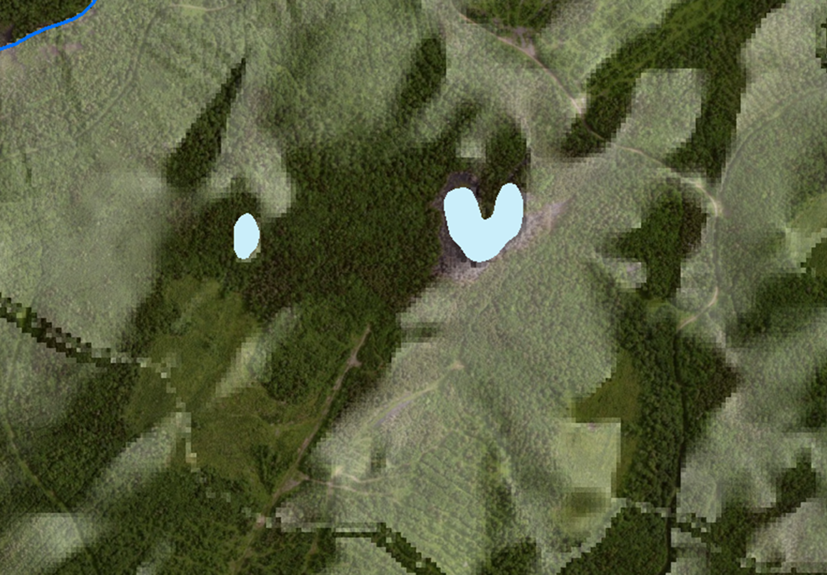
Two isolated (off network) ponds
Off Network ponds in BurnWaterBody
Notes:
In this example, two isolated ponds in BurnWaterBody are displayed. These ponds have a value of zero in the OnOffNet field. Notice that there are no linear streams touching or passing through these features.

Slide 16
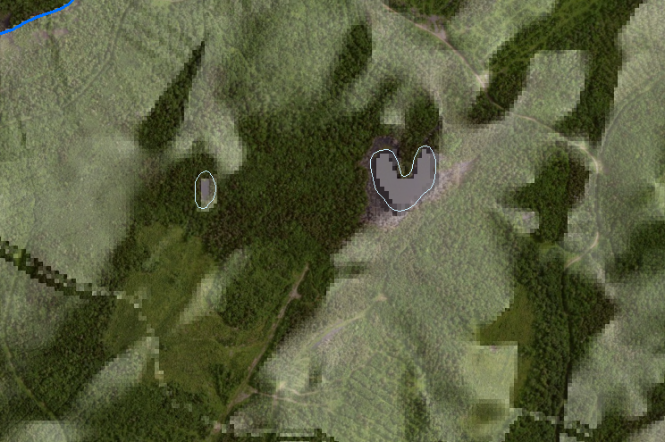
Two isolated (off network) ponds. Elevation cells in polygon flattened, dropped and filled to the height of the lowest surrounding elevation cell
Off Network ponds in BurnWaterBody
Notes:
These isolated ponds are enforced into the HydroDEM by first rasterizing each feature. The minimum elevation cell within each waterbody from the source DEM is determined. All elevation cells within each zone (each unique waterbody) are set to the minimum elevation in the DEM; a process called flattening. Next the waterbody elevation cells are dropped by 100 meters. Then with the ArcGIS Fill command, the elevation cells within each lake are raised to the lowest elevation cell surrounding the rasterized lake feature. This process helps ensure the entire lake area drains to a specific pour point in the HydroDEM.

Slide 17
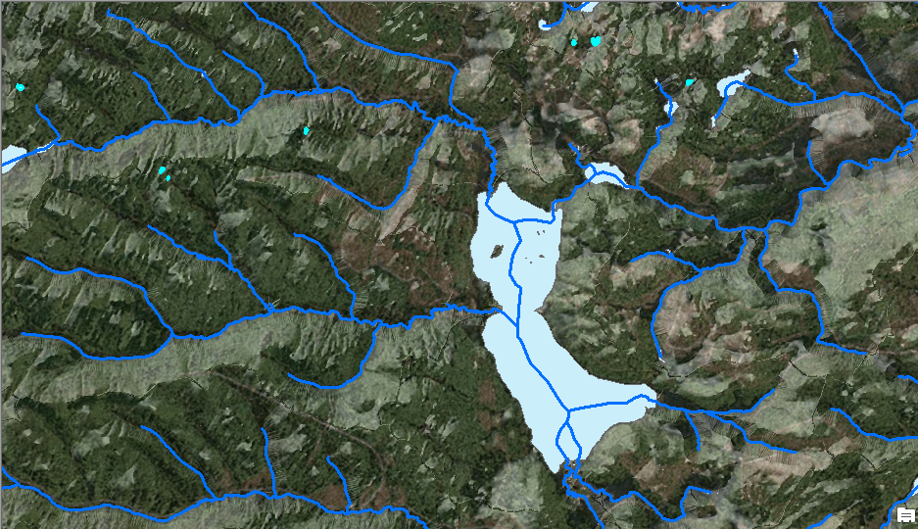
Networked lake
Networked lake in BurnWaterBody
Notes:
In this next example, a networked lake in BurnWaterBody is shown. This lake’s OnOffNet value is set to 1.

Slide 18
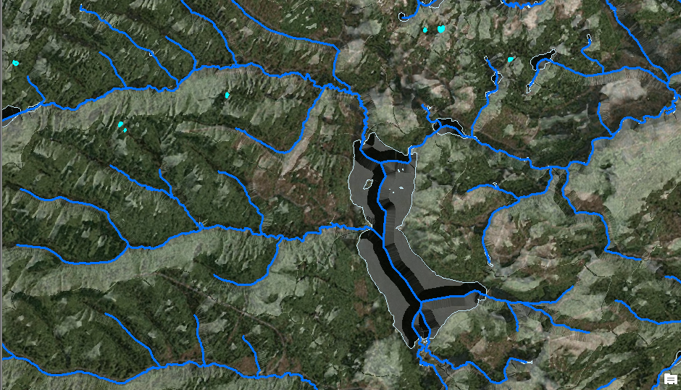
Elevation cells within a networked lake – creates a sloping gradient from the edge of the shorelines to “burned” in artificial path stream cells within it
Networked lake in BurnWaterBody
Notes:
The networked lake undergoes the same flattening and dropping enforcement as off-network lakes; however, additional enforcement is applied that directs the elevation cells from the lake shoreline edge towards the burned-in artificial paths using a sloping gradient. This process is referred to in the NHDPlus Users Guide as applying a “bathymetric gradient”.

Slide 19
Sink.shp – Point feature class
Attribute “BURN” is used to determine whether the point is used as a sink in hydro-enforcement. A sink will always be hydro-enforced unless the “Burn” attribute is set to NO.
During the hydro-enforcement fill process, areas that drain to sinks do not fill up and spill into down-gradient areas.
Attribute “CATCHMENT” is used to determine whether the point is used as a source for catchment delineation. Catchment = “N” (no) – the point will not be used to create a catchment
Attribute “PurpCode” is used to identify the purpose of the feature. Examples include:
Sinks at network ends, where the mapped surface water ends
Sinks at low points in closed watersheds (HUC12) that lack mapped stream features
Sinks at playas (dried lake beds) or closed lakes
Sink
Notes:
The next burn component feature class to discuss is the Sink point feature class. Sinks are used to enforce areas that drain to these features, so that they do not fill up and spill into down-gradient areas. In effect, the area that drains to a sink represents a non-contributing drainage area. A sink will always be hydro-enforced unless the sink BURN attribute is set to NO (“N”).
Catchments for sinks are also determined for each sink feature. A catchment for a sink will not be generated if the sink’s CATCHMENT attribute is set to NO (“N”).
Sinks can represent multiple things, including the terminal end flowline of an isolated network in the NHD; a closed lake or playa; or low elevation points within a closed basin designated as such in the Watershed Boundary Dataset’s (WBD) 12-digit hydrologic unit boundary (HUC) data.

Slide 20
Wall.shp – line feature class
Locations of watershed divides used for hydro-enforcement.
Watershed Boundary Dataset (WBD) HUC12 divides are used as “walls”
Can include international sources of drainage divides for areas in Mexico and Canada
Walls are used during hydro-enforcement to direct the modeled drainage (overland flow) away from the known watershed divides.
Wall
Notes:
The Wall line feature class contains drainage divides used for hydro-enforcement. These features are mostly from WBD 12-digit HUC boundaries. The data can also include international drainage divides in Mexico and Canada that are in the WBD or from some other international data source.
The walls are used to enforce the WBD drainage divides in the hydro-enforcement process. In the HydroDEM’s flow direction grid, grid cells are directed away from the imposed watershed divides. This enforcement ensures catchment boundaries conform to the existing drainage divide data as much as possible.

Slide 21
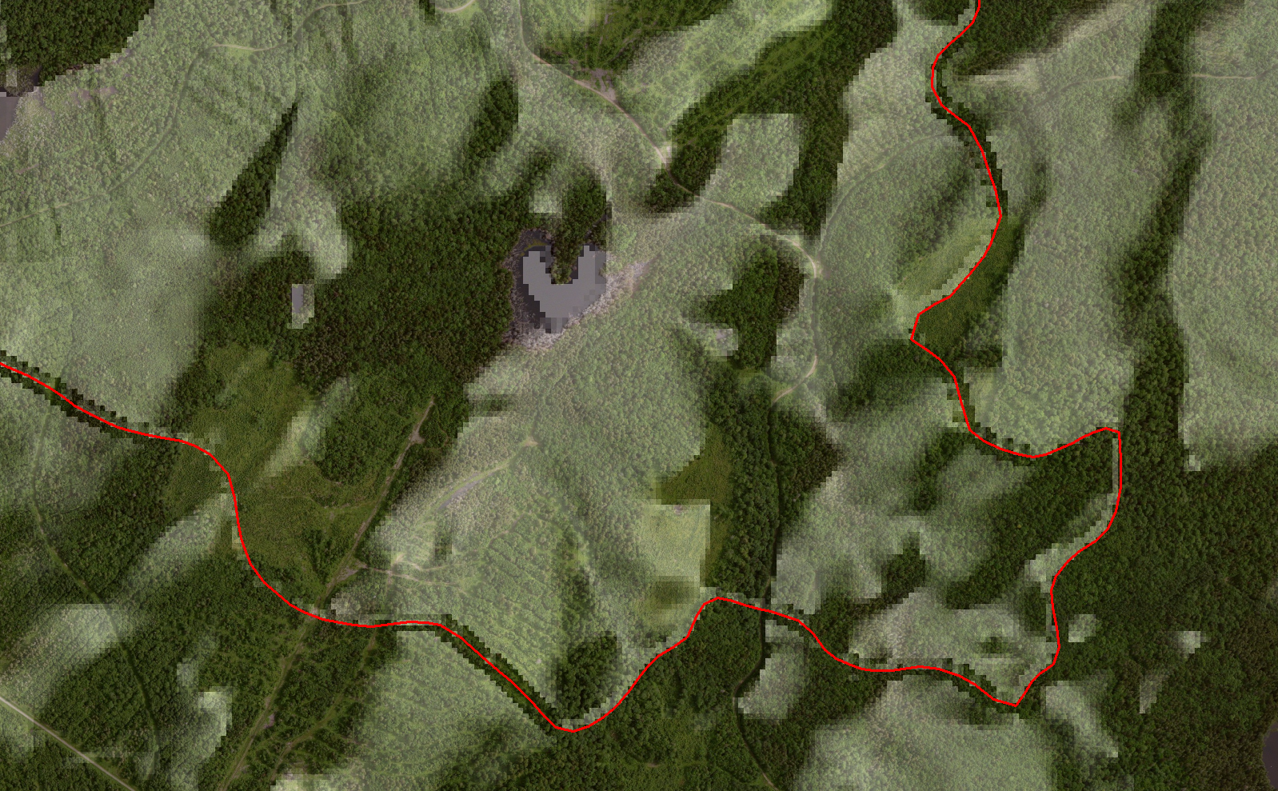
A drainage divide in the Wall feature class
Notes:
This example shows a drainage divide (shown as a red line) from the WBD in the Wall feature class overlaid onto a shaded relief image of the HydroDEM.

Slide 22
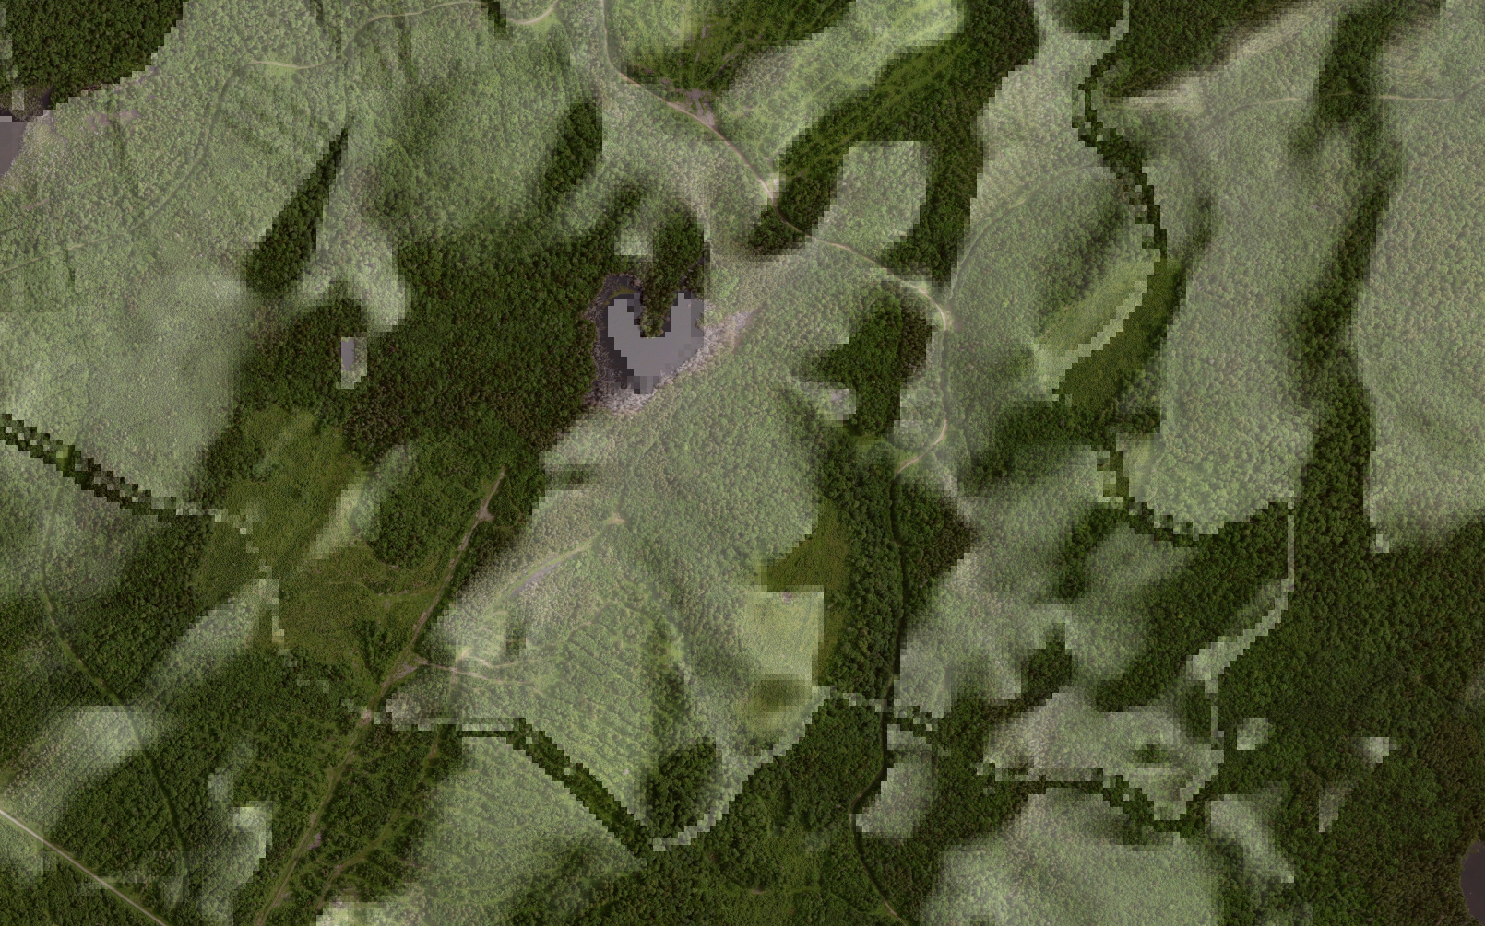
HydroDEM burned in wall features
visible in shaded relief image
Notes:
By not displaying the line from the Wall feature class in this image, one can see the artifact of the wall feature in the HydroDEM. The walls are enforced by vertically exaggerating the underlying elevation cells in the DEM.

Slide 23
LandSea.shp – polygon feature class
Polygons used for hydro-enforcement along coastlines
Attribute “LAND” is used to whether a polygon along the coast is:
Land = 1 : the polygon represents land
Land = -1 : the polygon represents an estuary
Land = -2 : the polygon represents an ocean area
These polygons are used in the hydro-enforcement by enforcing the ocean area to be the lowest level
Estuaries are enforced at a slightly higher level than the ocean, causing the modeled drainage to flow to the ocean
LandSea
Notes:
The last NHDPlus Burn Component to discuss is the LandSea polygon feature class. This particular feature class is populated for VPUs that consists of a coastline in the NHD. This would include all VPUs that define the Atlantic Ocean, Pacific Ocean, Gulf of Mexico, and Great Lakes shoreline.
Enforcement along the coastline ensures that all elevation cells have data on the landward side of the NHD coastline and that ocean area cells are the lowest elevations. The Attribute LAND designates one of three possible polygon types. A LAND value of 1 indicates the polygon represents land. Ocean areas in LandSea have a LAND value of -2.
Estuaries are coastal bays that are sometimes separated from ocean areas in LandSea. If an estuary is enforced for a given coastal VPU, it will be found in the LandSea polygon feature class with a LAND value equal to -1. Estuaries are enforced to be slightly higher than the ocean, causing the modeled drainage within the estuary to flow to the ocean. Usually if an Estuary is present in LandSea, there will be additional enforcement through these with BurnAddLine features.

Slide 24
Resources
Additional information on NHDPlus is available from the NHDPlus website documentation page. You are encouraged to read and reference the NHDPlusV21 User Guide and other NHDPlus documentation.
The NHDPlus team maintains a user email list and periodically sends emails regarding new tools, data, documentation, and events. If you would like to be on the user list, send an email to nhdplus-support@epa.gov
The NHDPlus team also provides technical support to users of the data and tools. If you have a technical support question, please send a detailed email to nhdplus-support@epa.gov
Notes:
I hope you found this presentation useful and gained a better understanding of the burn components of NHDPlus.
Additional Resource information on NHDPlus is available from the NHDPlus website documentation page. You are encouraged to read and reference the NHDPlusV21 User Guide and other NHDPlus documentation.
The NHDPlus team maintains a user email list and periodically sends emails regarding new tools, data, documentation, and events. If you would like to be on the user list, send an email to NHDPlus@hscnet.com
The NHDPlus team also provides technical support to users of the data and tools. If you have a technical support question, please send a detailed email to NHDPlus@hscnet.com

Slide 25
Notes:
Thank you. This concludes our presentation on the NHDPlus Burn Components.

