Slide 1
NHDPlus National and Global Data
Tim Bondelid
NHDPlus Training Series
Notes:
The NHDPlusV2 Training Series is designed for new and experienced NHDPlus users. To get the most from the Series, students new to NHDPlusV2 are encouraged to read up through the "NHDPlusV2 Versioning System" section of the NHDPlusV21 User Guide, download and install some NHDPlus data (as described in Exercises 0 and 1 on the web site), and spend time exploring the content of NHDPlus.
The Training Series does not cover how the NHDPlusV2 components were built. This information can be found in Appendix A of the NHDPlusV21 User Guide.

Slide 2
Objectives
Learn what the NHDPlusNationalData contains and how it can help in your work
Learn what the NHDPlusGlobalData contains and how it can help in your work
Introduction
1
Notes:
At the completion of this training session you will understand what is in the NHDPlusNationalData and the NHDPlusGlobalData and how the data can help you in your work.

Slide 3
Agenda
Where to get the data
NHDPlusNationalData:
USGS Streamflow Gages
Watershed Boundary Dataset (WBD) Snapshot
NationalCat Grid
NHDPlusGlobalData:
BoundaryUnit
Supercatchments
Introduction
2
Notes:
Here is a list of what is in each group. The rest of this presentation will explain what each of these datasets is and illustrate some ways the data can be used.

Slide 4
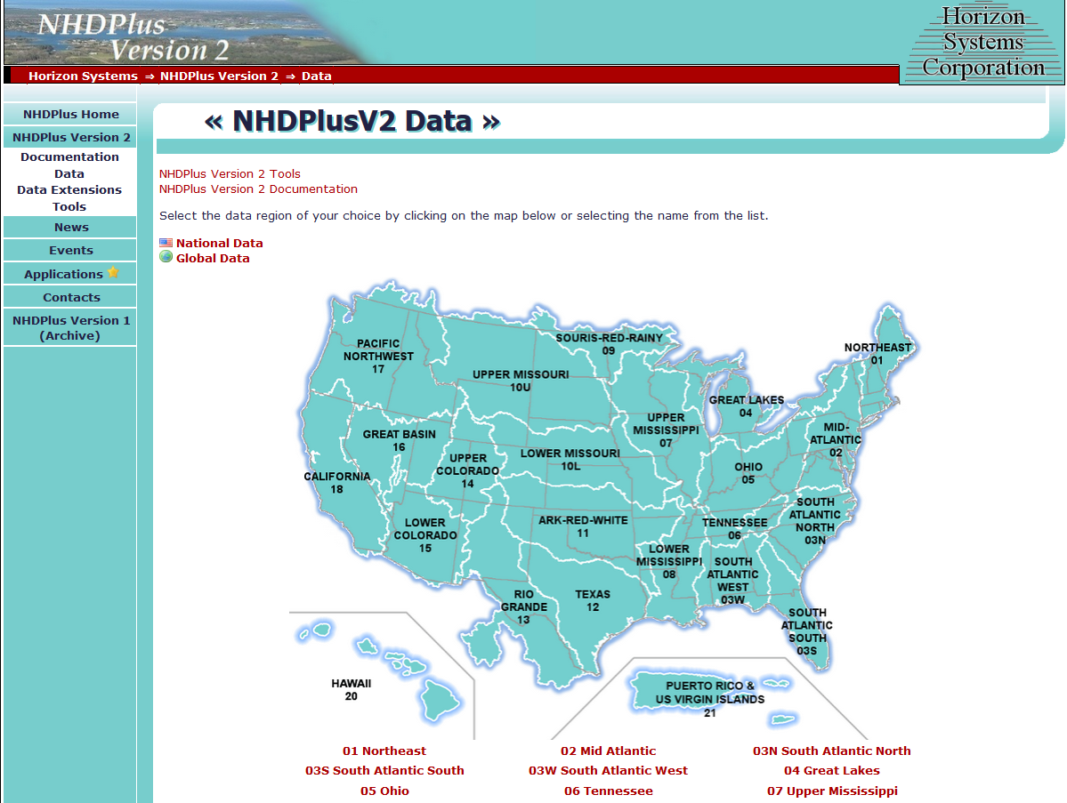
3
Notes:
The National and Global data sets can be downloaded from the NHDPlus Data Page at the link indicated by the arrow on this slide.
Note that after downloading, the data are unpacked into separate folders in Your NHDPlusV21 directory named “NHDPlusNationalData” and NHDPlusGlobalData”.

Slide 5
NHDPlusNationalData
Category | Files | Purpose
USGS Stream Flow Gages | GageLoc Shapefile | Gages Linked to NHDPlus Reaches (and Flowlines)
 | GageInfo.dbf | Basic Information about Gages
 | Gage_Smooth.dbf | Mean Annual and Mean Monthly flows at gages
Watershed Boundary Dataset (WBD) SnapShot | ShapeFile and File Geodatabase | Provides a cross-link capability between NHDPlus and WBD
National Catchment Grid | NationalCat ESRI Grid | A grid of all Catchments (for display purposes)
NationalData
4
Notes:
This slide provides more details about what is in each of the 3 major groups of files in NationalData.
NHDPlus is all about rivers and watersheds, and stream flow is fundamental. There are three datasets related to USGS stream flow gages. The Watershed Boundary Dataset, known as the WBD, is a hierarchical set of watershed boundaries; NHDPlus uses these boundaries as part of defining the catchments, so the NHDPlus catchments tend to fit well with WBD .

Slide 6
Gageloc
ShapeFile with Locations of 26,000+
USGS streamflow Gages
Field Name | Description
Source_Fea | GageID/NWIS Site Number
ReachCode | The Reachcode where the Gage is located
Measure | The Measure along the Reach
Featuredet | URL to Gage Data (NWISWEB)
FLComid | The NHDPlus Flowline Comid where the Gage is located
NationalData
5
Notes:
Within the Gageloc Shapefile data, The Source_Fea field provides the gageid link to other gage data. This information can be used, for example, to access current or historical flow measurements. Reachcode and Measure link to the flowlines. Featuredet can be very useful for data mining as it provides the URL link directly to the USGS NWIS gage site where the information described above regarding flow measurements can be obtained . FLComid can link you directly to the NHDPlusV21 Comid.

Slide 7
GageInfo
Table (.dbf) with ~28,000 USGS Gages
Field Name | Description
GageID | GageID/NWIS Site Number
Station_NM | NWIS Station Name
State_CD | The State numeric FIPS code
State | The State 2-character FIPS code
SiteStatus, ActiveDate | “A” = Active, “I” = Inactive. Date this status
DASqMi, DASqKm | NWIS Gage Drainage Area (DA). Missing DA = -999999
LatSite, LonSite | The NHD Lat/Lon in decimal degrees
Active, ActiveDate | 0=Inactive, 1=Active. Date status determined
GagesII | Blank, “Non-Ref”, “Ref”
NationalData
6
Notes:
The GageInfo table contains some very useful information for most of the gages in the gageloc shapefile. In particular, note the Sitestatus, Drainage Area(DA), Lat/Lon, Active/Inactive and GagesII fields. It is very important and also useful to compare to the NHDPlus cumulative DA . DA’s may be missing for gages for various reasons, including when gages are affected by significant flow transfers. The GagesII field can be very useful; these gages have been screened by USGS staff to be very useful for flow estimation work.

Slide 8
Gage_Smooth
A table (.dbf) of Mean Annual and
Mean Monthly flows
(7.2 Million Records)
Field Name | Description
Site_No | GageID/NWIS Site Number
Year | The Year for the Mean Flow. (1863 to 2008)
Month | The Month. “MA” = Mean Annual, “01”, “02”, … = January, February …
Ave | Mean Flow for the Gage Year and Month
CompleteRE | 1 = Complete record for the Gage Year and Month. Always = 1.
NationalData
7
Notes:
This table has the “odd” name Gage_Smooth; it got that name from one of the flow volume calculation steps that is named “Gage Smoothing”. The data in this table can be used, for example to develop monthly or annual time series at gages and determine completeness of the data for analysis .

Slide 9
How EROM Uses Gage Data
GageLoc: Finds Gages on the Flowlines.
GageInfo: Subsets Gages where
NHDPlus Drainage Area (DA) is +/- 20% of NWIS DA.
Gage_Smooth: Computes Mean Flow
where there are at least 10 Years
of record from 1971-2000.
These Mean Flows are used for Flow Adjustments and QA
NationalData
8
Notes:
This is an example of how the gage data can be used. This is how The Enhanced Runoff Method (EROM) uses it. First, Gageloc finds the gages on flowlines. Next, Gageinfo gets the gage drainage area. Third, Gage_smooth computes the mean annual or mean monthly flow at the gage. Suggest to briefly introduce EROM (as method to estimate flows in NHDPlus) with reference to User Guide for details.

Slide 10
NationalWBDSnapShot
The Watershed Boundary Dataset (WBD) is a national standard database of watersheds
WBD nested at the HUC2 to HUC12 levels
NHDPlus uses the HUC12 WBD as “walls” to Hydro-enforce catchment boundaries
This does two important things for NHDPlus:
NHDPlus is 1:100k, WBD is 1:24k or better
Provides a close link between these two national standard watershed definitions
NationalData
9
Notes:
The Watershed Boundary Dataset, WBD, is a key part of building catchments for NHDPlus. WBD is used by many Federal and State organizations for tracking water resources and water quality information.

Slide 11
NationalWBDSnapShot
Go to NHD.USGS.GOV for more information about WBD
Watershed Definitions
Name | Level | Digits | Number of HUCs
Region | 1 | 2 | 22
Subregion | 2 | 4 | 223
Basin | 3 | 6 | 387
Subbasin | 4 | 8 | 2,300
Watershed | 5 | 10 | 18,377
Subwatershed | 6 | 12 | 100,499
NationalData
10
Notes:
These are some statistics on the current numbers of watersheds at each level of the WBD. Go to NHD.USGS.GOV for more information.

Slide 12
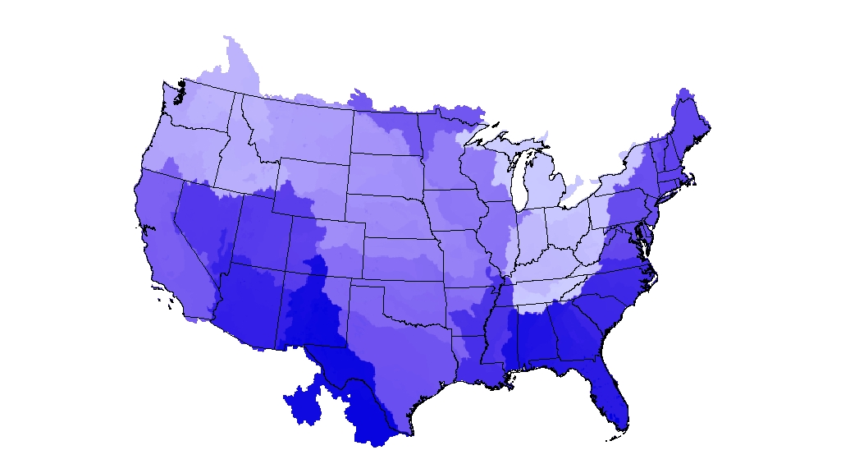
NationalCat Grid
NationalData
11
Notes:
The last component of the NationalData set is the NationalCat grid. The grid is provided to users interested in a national dataset of catchments. The catchments show in color groups based on the FeatureID values; not that they tend to group by Vector Processing Units.

Slide 13
GlobalData: BoundaryUnit
A Polygon Shapefile with the boundaries
of the Geographic Units used for
building and organizing NHDPlus
Field Name | Description
DrainageID | Drainage Identifier
UnitID | Boundary Unit Unique Identifier
UnitName | Boundary Unit Name (For VPUs)
UnitType | Boundary Unit Type (“VPU” or “RPU”)
AreaSqKm | Area of the Unit
GlobalData
12
Notes:
Boundary Unit is very useful to determine exactly what components you need for the geographic extent of your particular project (Vector Processing Units (VPUs) and Raster Processing Units (RPUs)). In effect, the BoundaryUnit shapefile gives an index or table of contents to quickly find the NHDPlus areas of interest.

Slide 14
BoundaryUnit
Relationship to the NHDPlus directory structure
Field Name | Value | Directory Structure
DrainageID | MA | \NHDPlusMA
UnitID | 02 | \NHDPlus02
UnitName | Mid-Atlantic
UnitType | VPU
AreaSqKm | 277754.2695
Field Name | Value | Directory Structure
DrainageID | MA | \NHDPlusMA
UnitID | 02a | \NHDPlus02
UnitName
UnitType | RPU | \NHDPlusFdrFac02a
AreaSqKm | 172495.4481
GlobalData
13
Notes:
BoundaryUnit records relate directly to the NHDPlus directory structure. Here are two examples of how records in the BoundaryUnit Table relates to the NHDPlus structure.

Slide 15
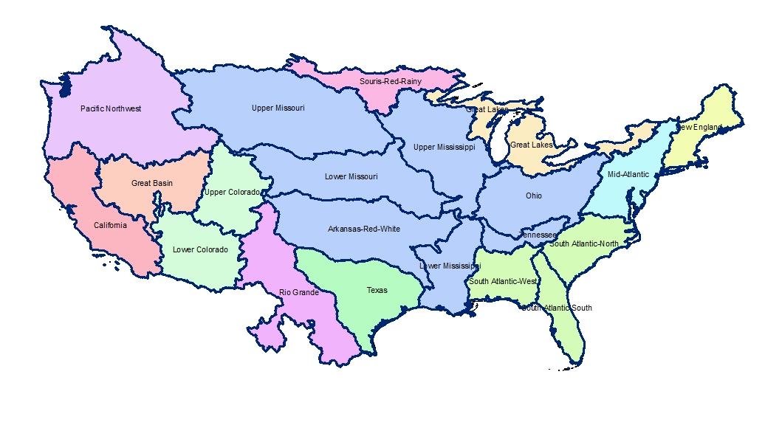
BoundaryUnit DrainageID, UnitName, UnitType=VPU
GlobalData
14
Notes:
This map shows Drainage areas, corresponding to the DrainageID in the BoundaryUnit records. Note that the Mississippi, Colorado, and South Atlantic Drainage Areas are divided into multiple VPUs. The map shows the VPUs by name.

Slide 16
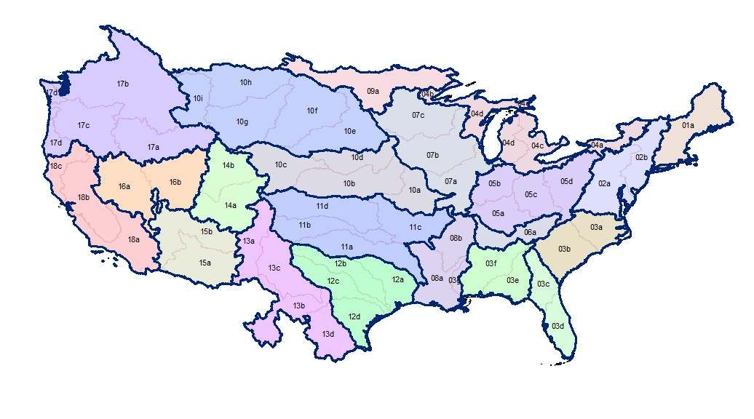
BoundaryUnit UnitID, UnitType=VPU, RPU
GlobalData
15
Notes:
This slide shows the geographic extent of the Raster Processing Units (RPUs) in each VPU.

Slide 17
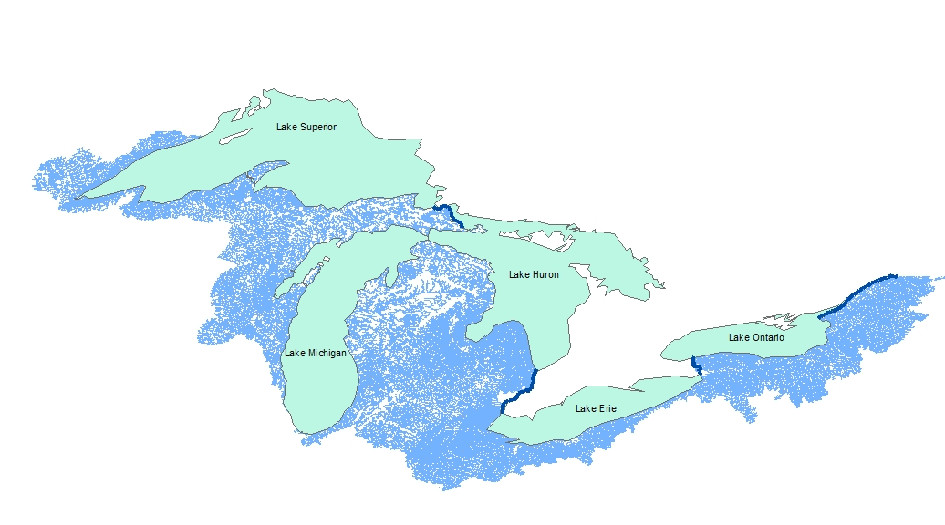
SuperCatchments
GlobalData
16
Notes:
SuperCatchments are currently used only in the Great Lakes. The four overlapping SuperCatchments represent the drainage areas of the outlets of the Great Lakes. They are provided in both shapefile and as grids.
By the way, the coverage showing the lakes is not part of NHDPlus.
NHDPlus does not have a network through the Great Lakes, but it does have the network on the rivers that connect the lakes (shown in dark blue on the map). The purpose of Supercatchments is to provide the total drainage to each of these streams that connect the Great Lakes. The following slides will show how this works.

Slide 18
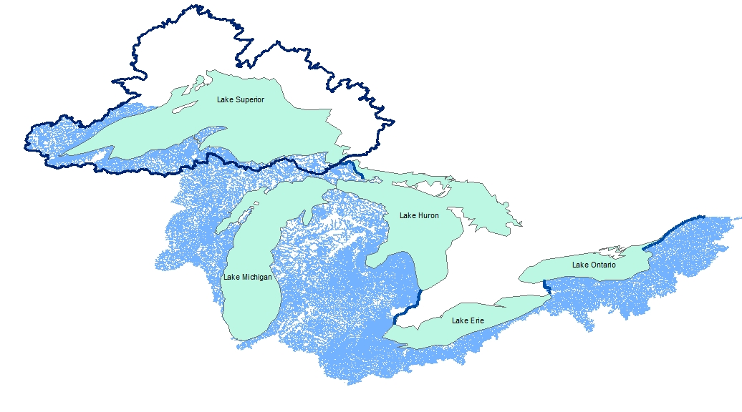
SuperCatchments
St. Mary’s River
GlobalData
17
Notes:
There is a SuperCatchment that connects to the flowline at the head of the St. Mary’s River, which represents the drainage area for Lake Superior.

Slide 19
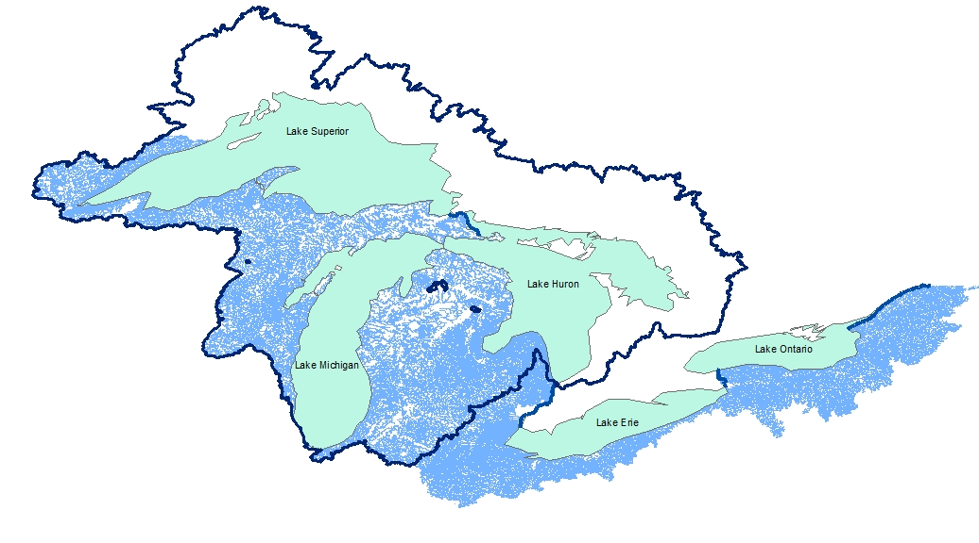
SuperCatchments
Detroit and St. Clair
Rivers
GlobalData
18
Notes:
This shows the SuperCatchment for the Detroit and St. Clair Rivers that represent the drainage area for Lake Huron.

Slide 20
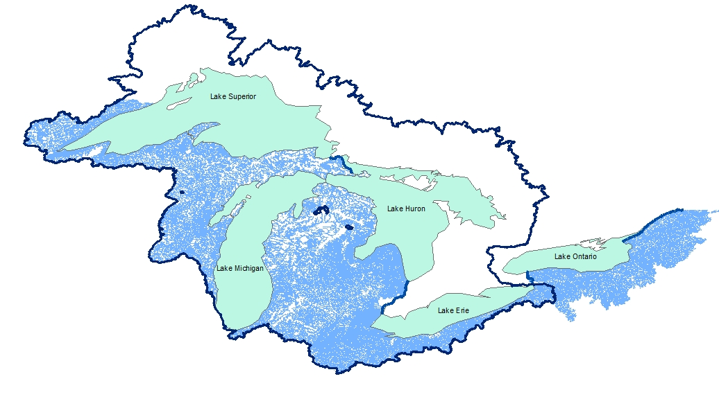
SuperCatchments
Niagara River
GlobalData
19
Notes:
Here is the SuperCatchment for the Niagara River that represents the drainage area for Lake Erie.

Slide 21
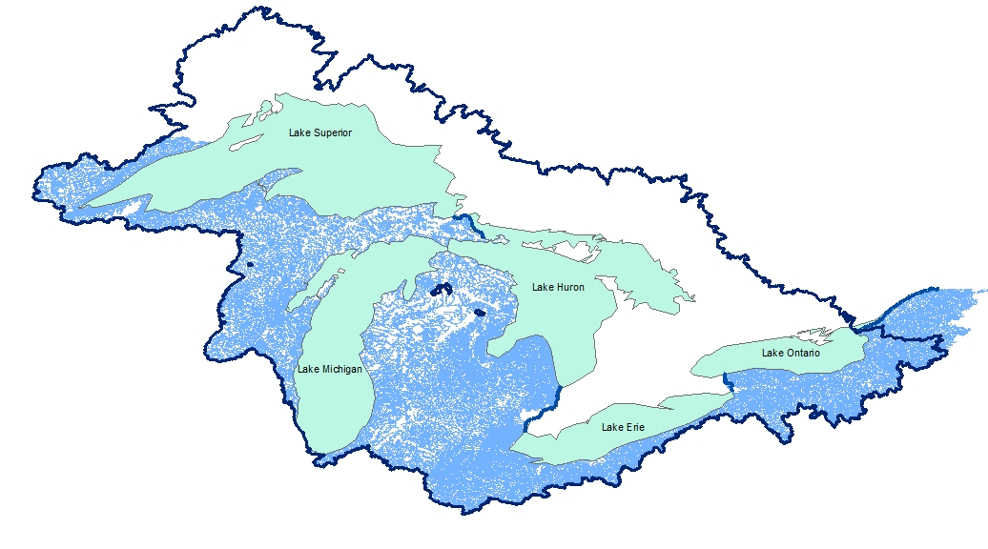
SuperCatchments
St. Lawrence River
GlobalData
Notes:
This is the entire drainage area of the Great Lakes, draining to the St. Lawrence River.

Slide 22
Resources
Additional information on NHDPlus is available from the NHDPlus website documentation page. You are encouraged to read and reference the NHDPlusV21 User Guide and other NHDPlus documentation.
The NHDPlus team maintains a user email list and periodically sends emails regarding new tools, data, documentation, and events. If you would like to be on the user list, send an email to nhdplus-support@epa.gov
The NHDPlus team also provides technical support to users of the data and tools. If you have a technical support question, please send a detailed email to nhdplus-support@epa.gov
Resources
21
Notes:
Additional information on NHDPlus is available from the NHDPlus website documentation page. You are encouraged to read and reference the NHDPlusV21 User Guide and other NHDPlus documentation.
The NHDPlus team maintains a user email list and periodically sends emails regarding new tools, data, documentation, and events. If you would like to be on the user list, send an email to NHDPlus@hscnet.com
The NHDPlus team also provides technical support to users of the data and tools. If you have a technical support question, please send a detailed email to NHDPlus@hscnet.com

